Slide 1

AIML Group Lab Team-7
AI Solution for Changing Weather Conditions

Slide 2
Agenda
Problem Statement
Assumptions
Response to the Questionnaire
Business Applications, Post course
Introduction to Team
References
Q & A

Slide 3
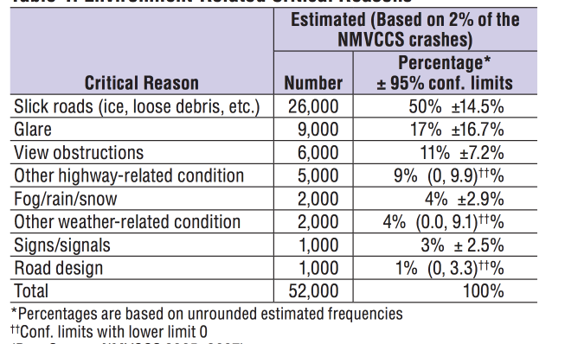
Problem Statement
8% of road accidents and fatalities reported are due to bad/abnormal weather conditions which were not detected by existing solutions and same needs to be addressed by Intelligent Solutions
To reduce road accidents from 8% to Nil by implementing Artificial Intelligence System which will dynamically adjust to weather appropriate driving styles

Slide 4
A few assumptions to begin with
The sensors are sharing accurate representative data
The notions of transfer learning are being applied on top of one of the trained models that is already being used in Autonomous driving, specifically, addressing the following aspects:
1. location, acceletrtion speed ect..
2. 3d Objects - Cars, trucks, pedestrians, cyclists etc()
3. 3d representation of weather conditions - fog, snow, rainy 3d images - this wil ne high resolution images 100k points per frame.
4. Stereo data(greyscale stereo and color sequences)

Slide 5
Key Facts about Proposed AI Solution
Data Set Required?
KITTI (Toyota)
IDD
City Scapes
Deficiencies in available data?
Drastic weather condition data availability
“Definition of corner case”
Problem Type?
Classification-Supervised Learning
Data representation?
Feature Extraction using Transfer Learning
Metric for solution effectiveness?
F1Score=(2*(Precision*Recall)/(Precision Recall)
Algorithm Proposed for Problem Solving?
Transfer learning with Learning using CNN

Slide 6
Data pre-processing
The images used for predictions should be of the same size - Image rescaling
In order to have an even playing field, we perform image normalisation
Dimensionality reduction to translate RGB scale to Grey scale (One of the open consideration points…)

Slide 7
Answers to the Questionnaire (Algorithms)
Feature Extraction
Scanning Stage
X
Beta
Classification
Y=f(X,Beta)
Yes
Avg Probablity <0.3?
Decision Making Stage
Translate Image to regular condition
No
Softmax
Action Stage

Slide 8
Two Mode Solution
Machine Mode (Autonomous Driving)
1
Human Mode (Human Takes over.Corresponding data used for further learning)
2

Slide 9
Business application and Post course
Our intention is to reduce to fatality rate
Post course, we would like to pursue this idea and at least come up with a model that can be retrofit into a transfer learning scheme
From a test point of view, we would like to use the “X” from the previously failed scenarios and see if our model would behave any different

Slide 10
Team (K3GVD)
Kalyan
Karthik
Kaushik
Girishankar
Vinay
Dhiren

Slide 11
References
https://www.wired.com/story/self-driving-cars-uber-crash-false-positive-negative/
https://www.budgetdirect.com.au/car-insurance/research/car-accident-statistics.html
https://gizmodo.com/deep-learning-can-now-flawlessly-correct-photos-taken-i-1825919192
https://medium.com/toyota-ai-ventures/self-supervised-learning-a-key-to-unlocking-self-driving-cars-408b7a6fd3bd
https://becominghuman.ai/image-data-pre-processing-for-neural-networks-498289068258

Slide 12
Q & A

Slide 13
Thank you!

